Slide 1
Air France Business Case
Growing in the U.S.: how to evolve, what to optimize

Slide 2
Analysis Plan
Problem Statement
Increasing growth strategy
Optimize Return on Advertising
Data Analysis
Most remunerative websites
Principal keywords
Intermediates: useful or not?
Recommendation
Air France’s strategy in U.S.

Slide 3
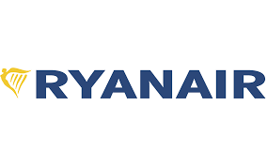




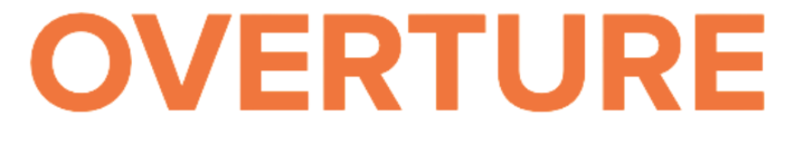
Problem Statement
Objectives: International growth
Increase marketshare U.S.
Competitors: Ryanair
L’avion
Search Engines: Google
Yahoo!
MSN
Overture
Which Keywords are most effective?
Which Publisher provides the best advertisement performance?

Slide 4
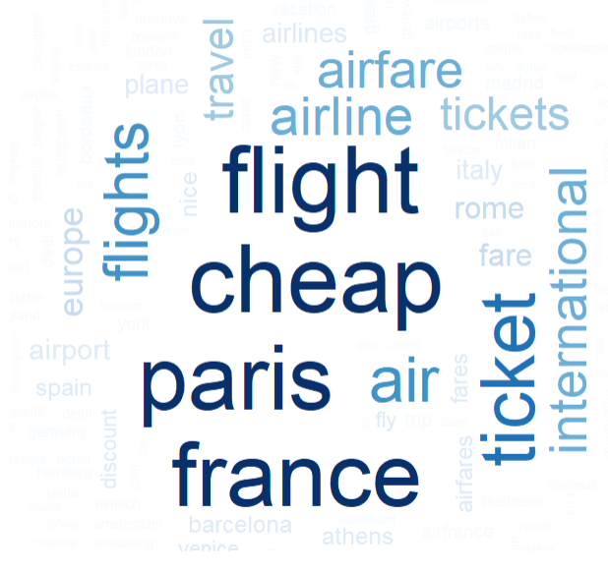
Keywords Analysis
Most frequent keywords:
- Paris
- Cheap
- Flight
- France

Slide 5
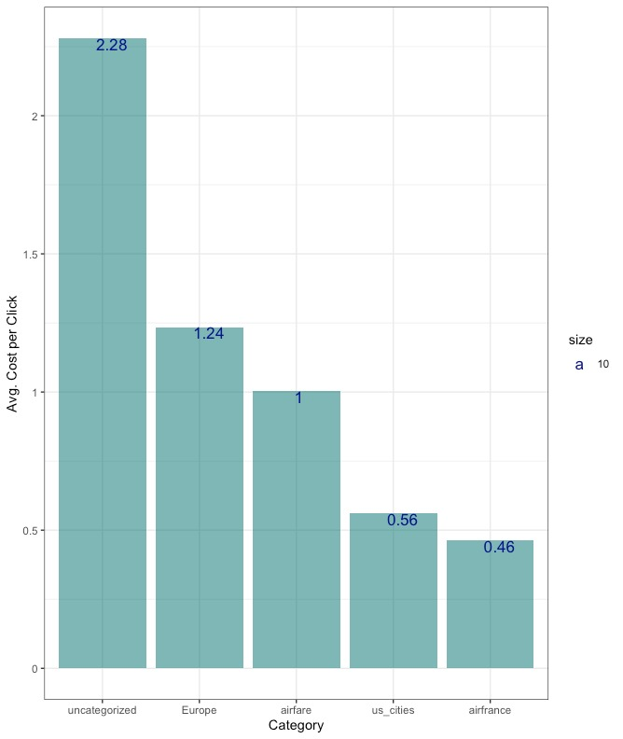
Keyword Analysis
Keyword Category - Avg. Cost per Click:
Highest Cost per Click: Uncategorized words
Lowest Cost per Click: ‘U.S. cities’; ‘Airfrance’
Notes:
Explain what “uncategorized” mean. Interest of AirFrance management. AirFrance focused buckets analyze categorized “Europe, Airfare, Us_cities, airfrance” Mention unit in dollar.

Slide 6
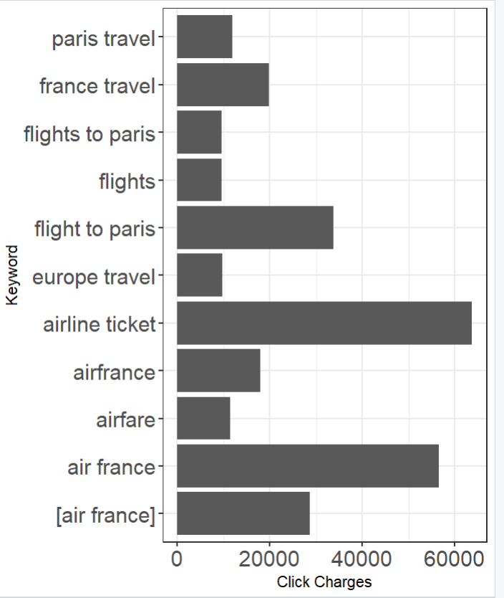
Keyword Analysis
Key Keyword vs Click Charges
Most expensive click charges: ‘airline ticket’

Slide 7
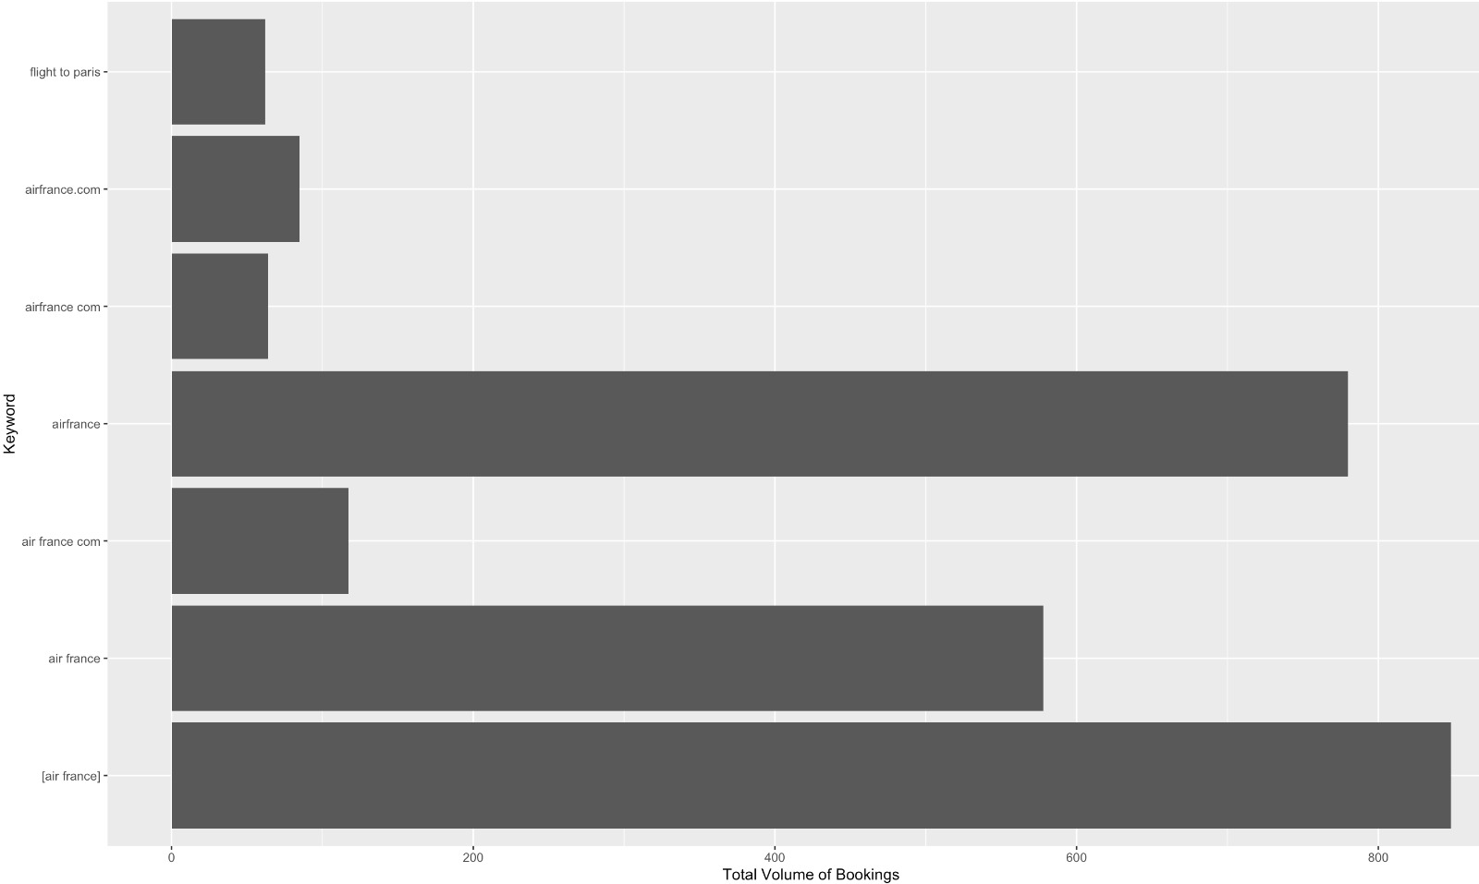
Keyword Analysis
Keywords - Total Volume of Bookings
Keywords – booking:
‘air France’,
‘air france.com’
‘flight to paris’

Slide 8
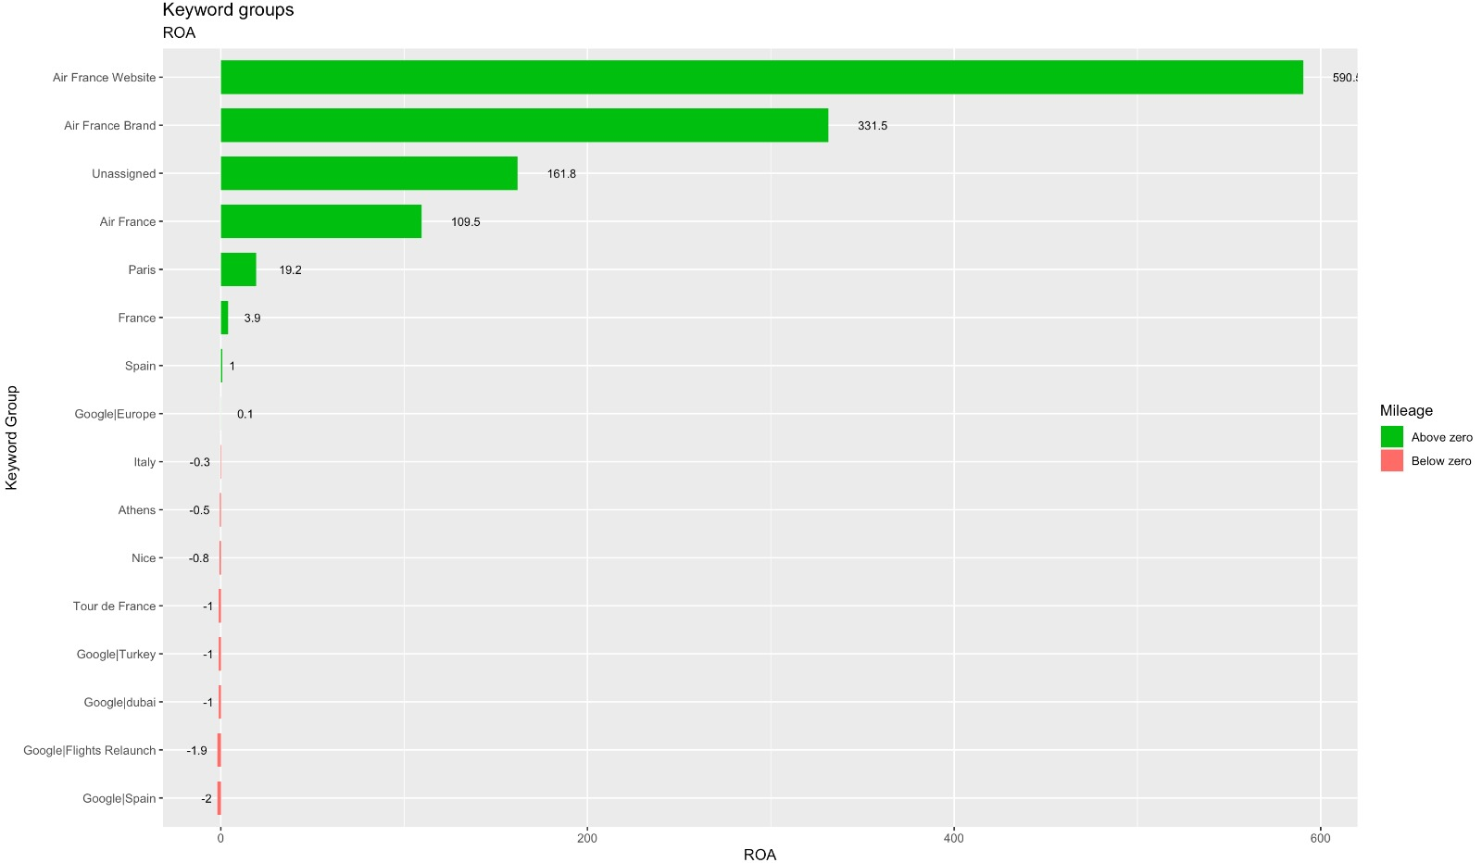
Keyword Analysis
Keyword Group - ROA
Positive ROA:
- Air France Website
- Air France Brand
- Unassigned
- Air France
- Paris
- France
- Spain.
Notes:
Presenter: Carlos 8-9

Slide 9
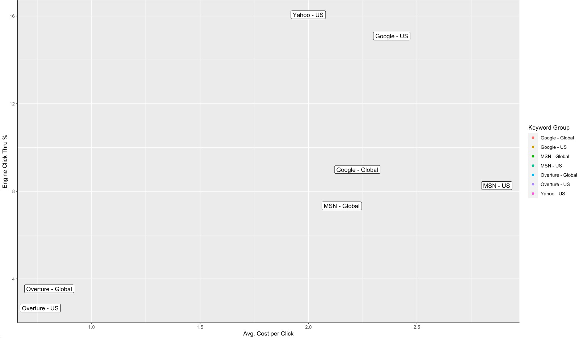
Publisher Analysis
Engine Click Thru % - Avg. Cost per Click:
Most efficient publisher: Yahoo-US
Notes:
Carlos

Slide 10
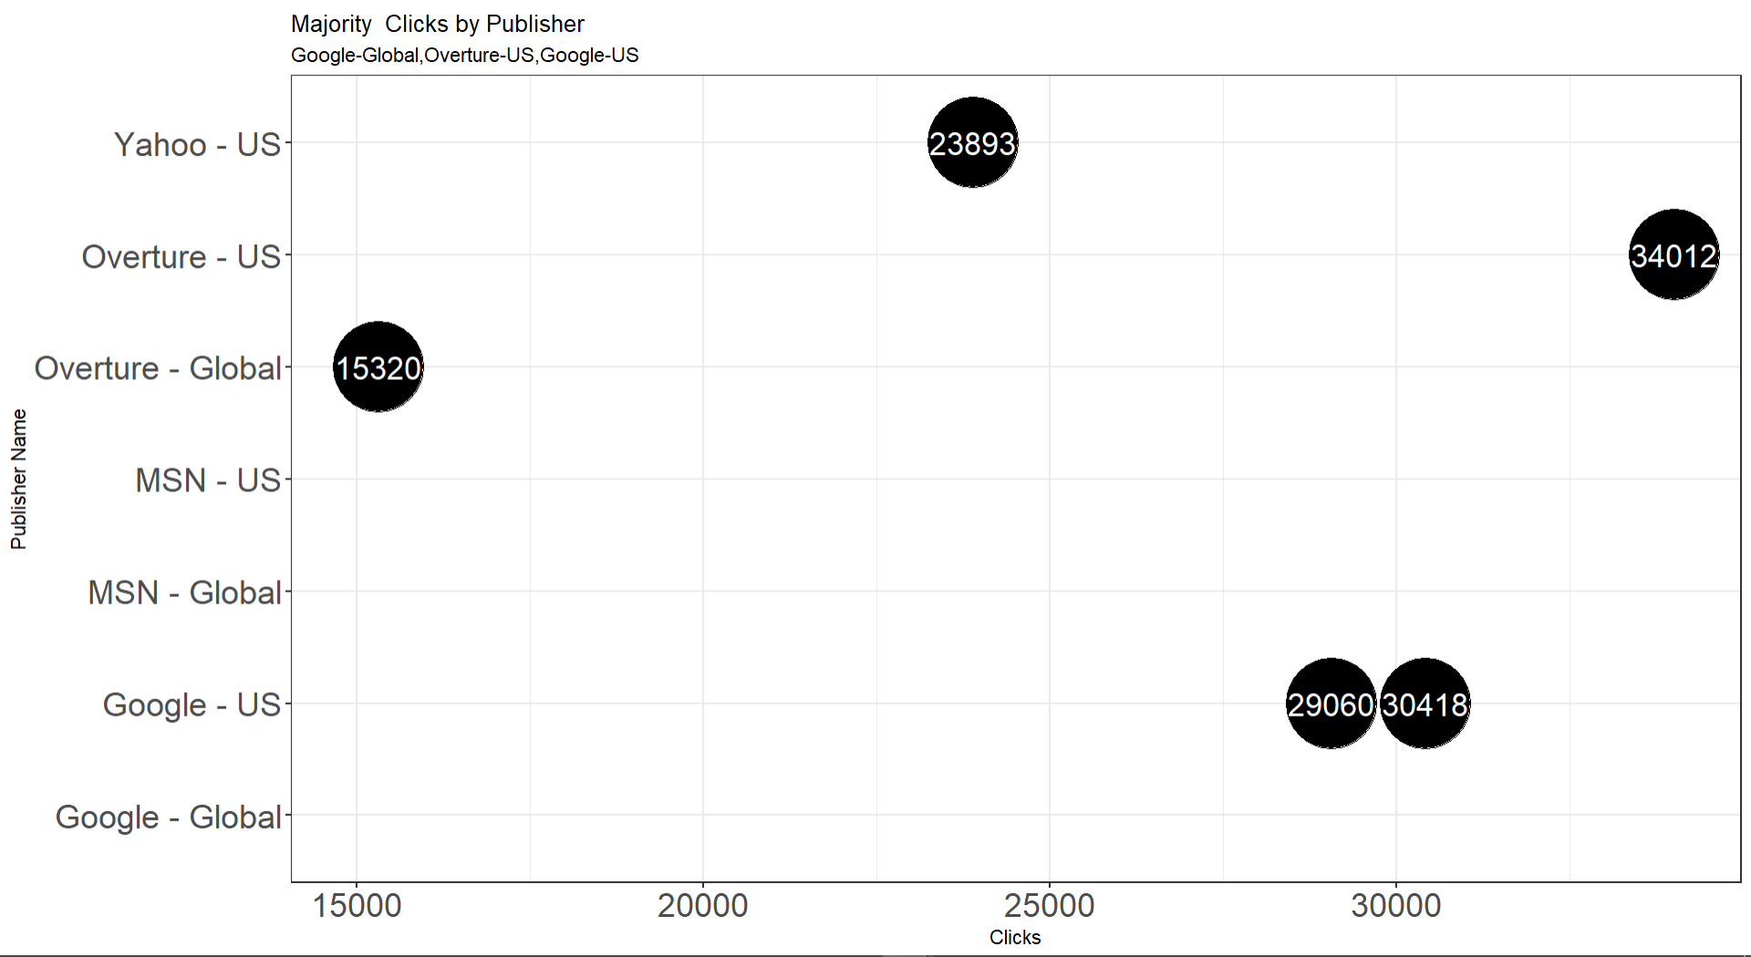
Publisher Analysis
Publisher – Clicks
+ 12%: difference in clicks Overture - Google
18,700: difference in clicks Overture US – Overture Global
Notes:
Prensenter Tommasso

Slide 11
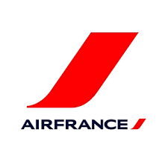
WHAT PERSPECTIVE FOR THE COMPANY?
Air France: most effective keyword
1%: increase in bookings without intermediates
Less dependence from intermediates will liberate resources for investments. Air France must use them to increase its amount of customers, which is, at the moment, stuck

